Slide 1

SE327: Methods of Data Analysis
Submitted To : Submitted By :
Ms. Shweta Meena Sarthak Doomra(2K21/CH/56)
(Assistant Professor) Shivay Vinaik (2K21/CH/60)
Department of Software Engineering Suryansh Kaushik (2K21/CH/65)

Slide 2

Zomato Dataset Analysis

Slide 3
About Dataset
This dataset is a collection of restaurants that are registered on Zomato in Bengaluru City. In this dataset, we have more than 50,000 rows and 17 columns, a fairly large dataset.
We have performed the following tasks in this project –
1. Exploring the dataset
2. Data Cleaning
3. Data Visualization

Slide 4
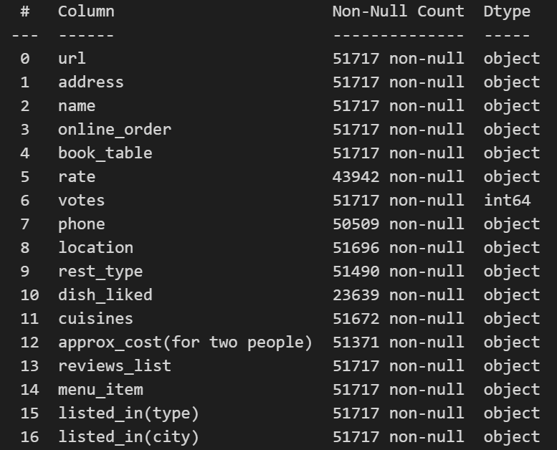
Information about columns
The dataset contains various columns including a rating column, the average cost for two people, and the types of cuisines offered by that restaurant. These columns are the major focus of our analysis.

Slide 5
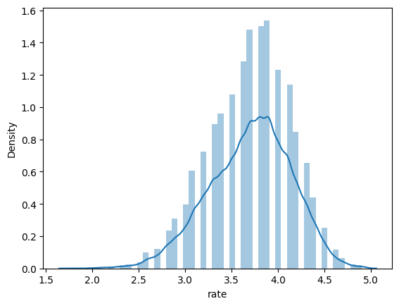
Skewness of Rating column
It is evident from the graph that the majority of the restaurants are rated between 3.5 to 4.0 . The data is found to be centralized when its mean, mode, and median are compared numerically.

Slide 6
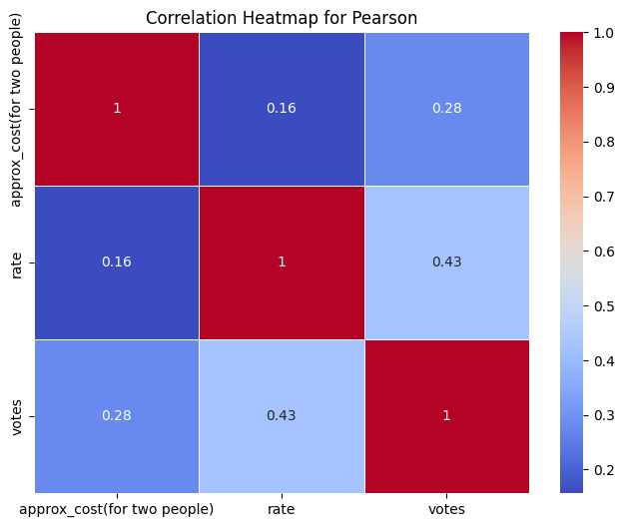
Relationship between the columns
The Pearson correlation coefficient between the variables is low to moderate and hence does not have a strong relationship. This implies that they are not dependent on each other and don’t have a significant effect on each other.

Slide 7
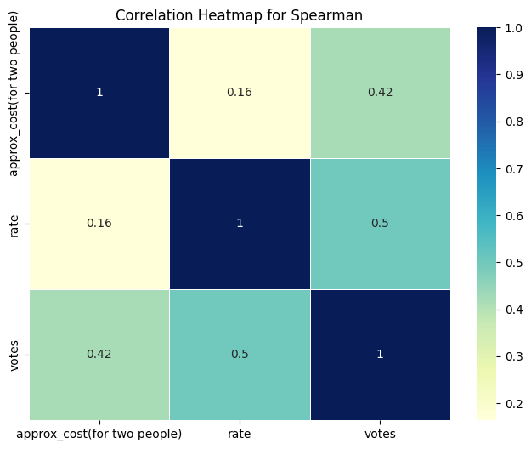
Spearman Relation
The Spearman correlation coefficient between the variables is low to moderate and hence does not have a strong relationship. This implies that they are not dependent on each other and don’t have a significant effect on each other.

Slide 8
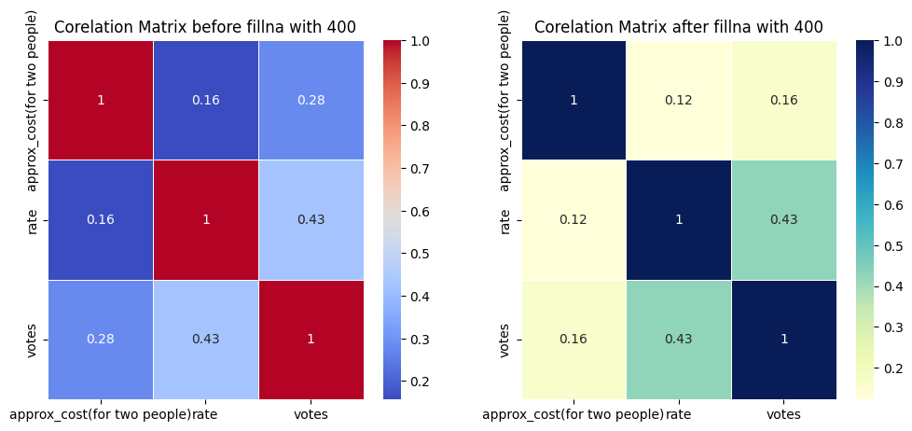
Effect on the relationship b/w variables after filling out empty values
No significant relationship is observed even after filling out the NAN values.

Slide 9
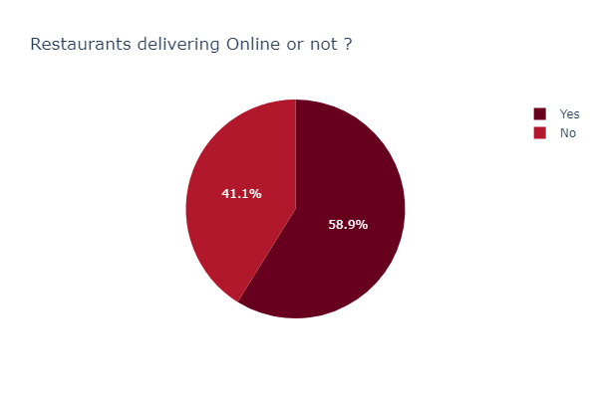
Online Delivery service
Around 59% of restaurants have the facility of delivering online foods through the platform of zomato

Slide 10
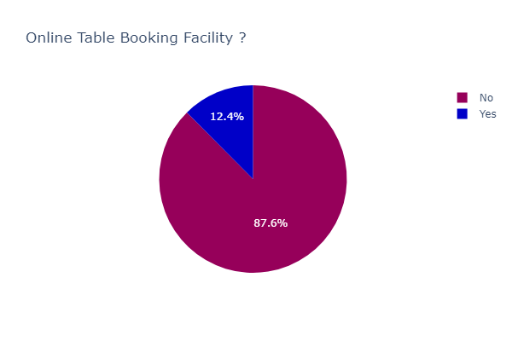
Table booking facility
Only 12% of restaurants have the facility of booking and reserving a table online.

Slide 11
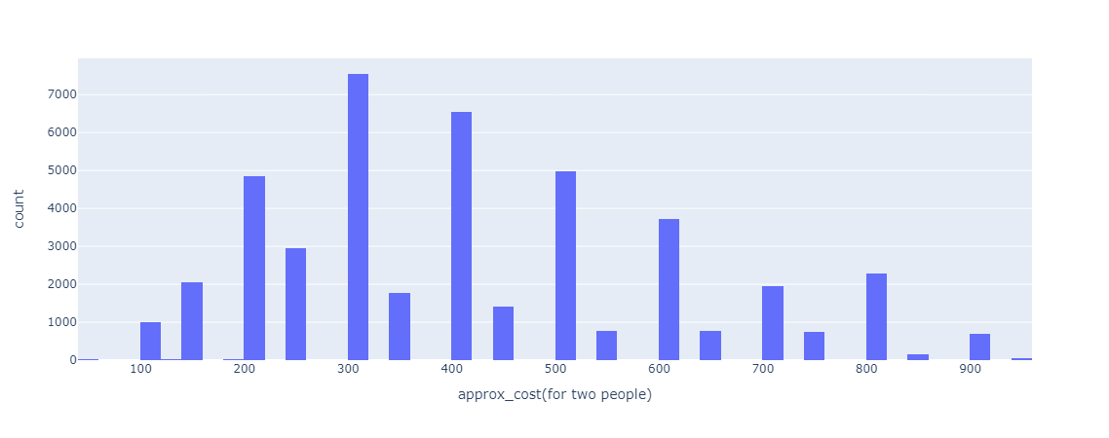
Approximate cost for two people
More than 7000 restaurants have an average cost of $300 for two persons. There are around 800 restaurants that have an average cost of approximately $900

Slide 12
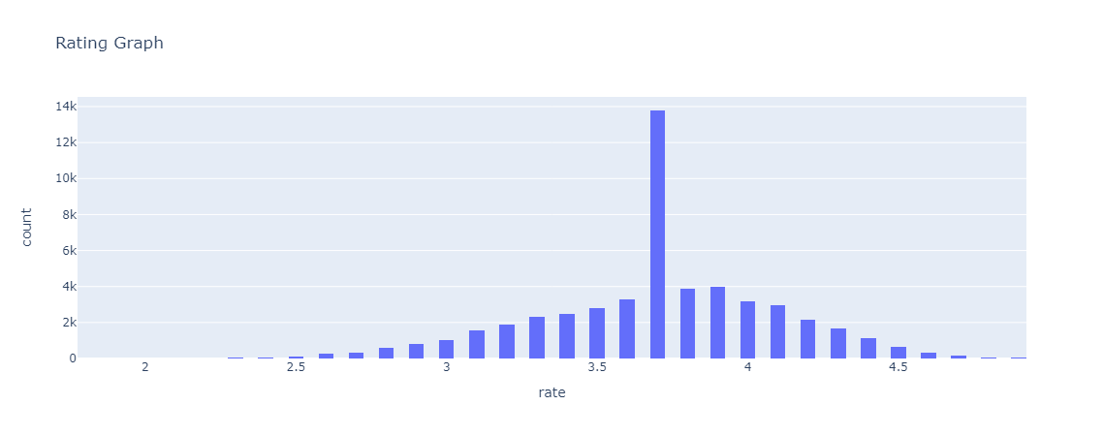
Rating Distribution
The restaurants are mostly given a rating of 3.7 on Zomato.

Slide 13
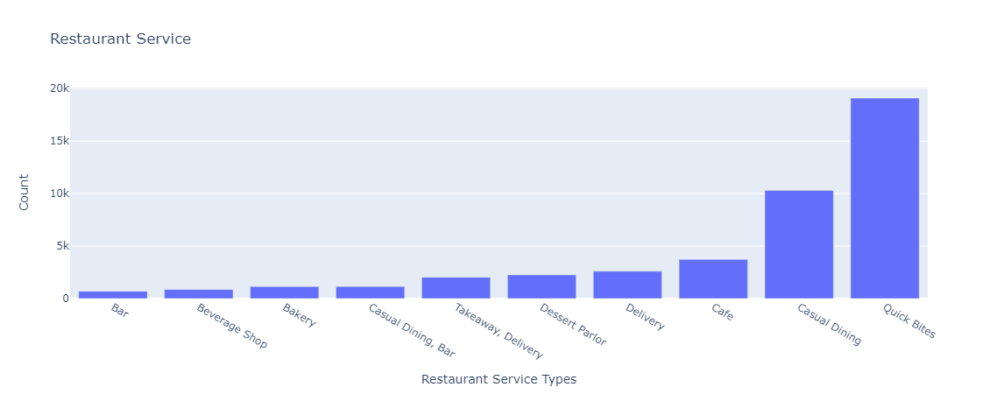
Types of Services offered
The most ordered food from Zomato is of type: Quick Bites and Casual Dining.

Slide 14
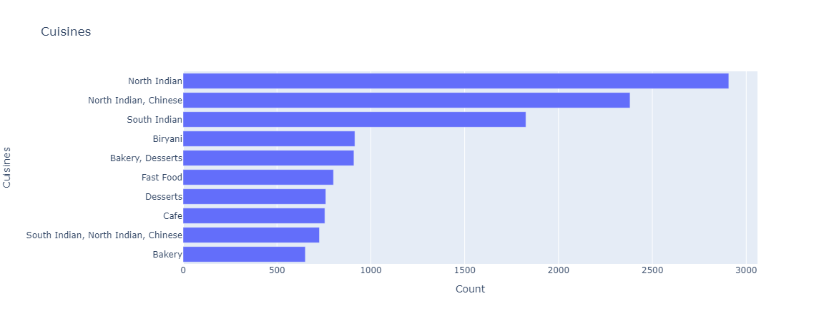
Types of Cuisines offered
The most ordered type of cuisine from Zomato is North Indian.

Slide 15
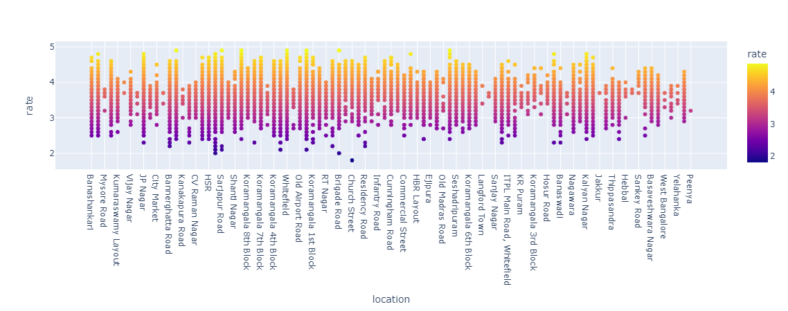
Distribution of rating w.r.t Location

Slide 16
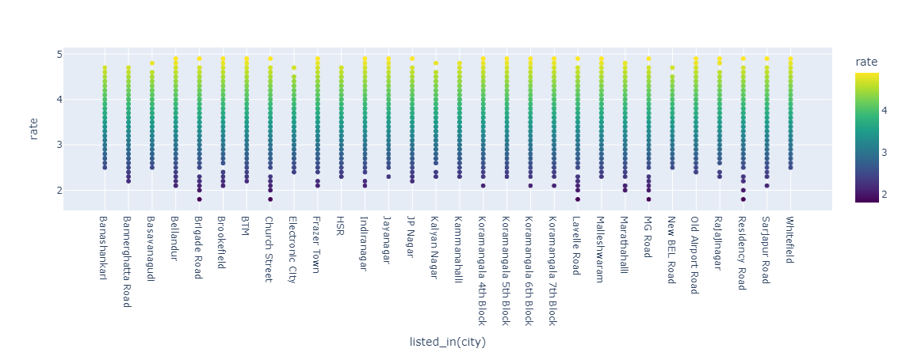
Distribution of rating w.r.t City

Slide 17
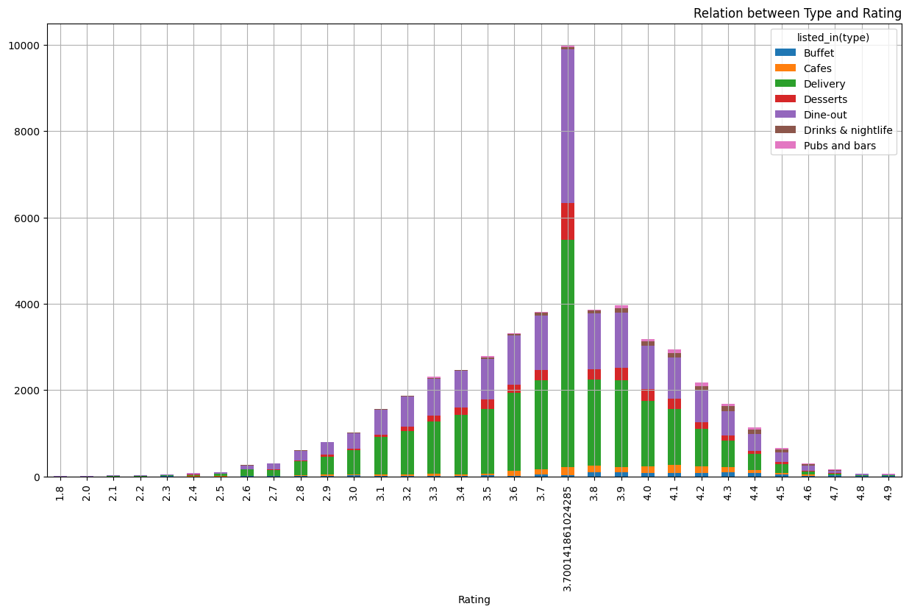
Distribution of rating w.r.t Service

Slide 18
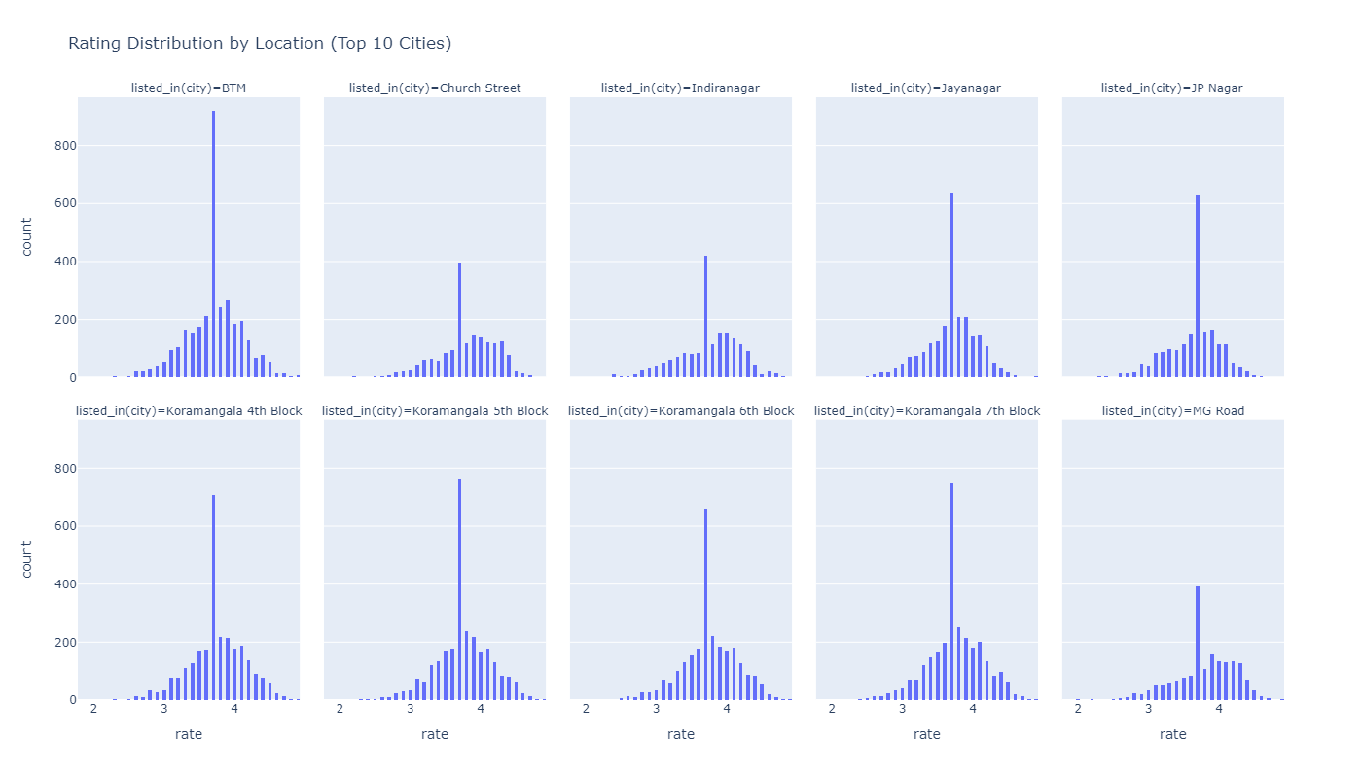
Rating’s distribution for top 10 locations

Slide 19
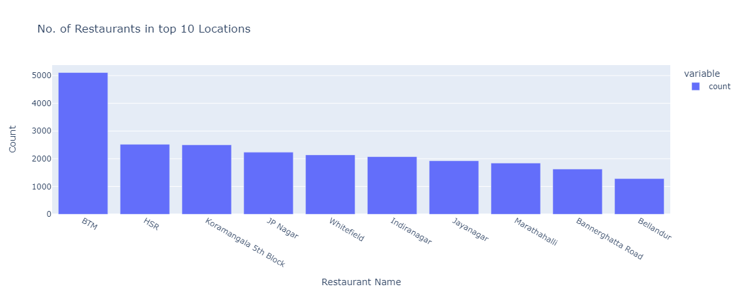
No of restaurants in top 10 locations
BTM has the most number of restaurants with a count of approx 5000.

Slide 20
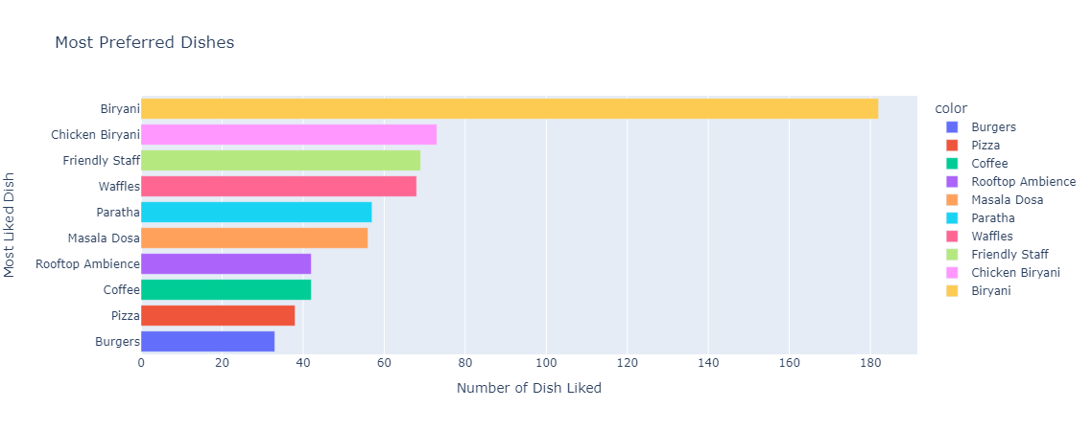
Top 10 most preferred Dishes
Biryani is the most preferred dish out of all the dishes listed on Zomato.

Slide 21
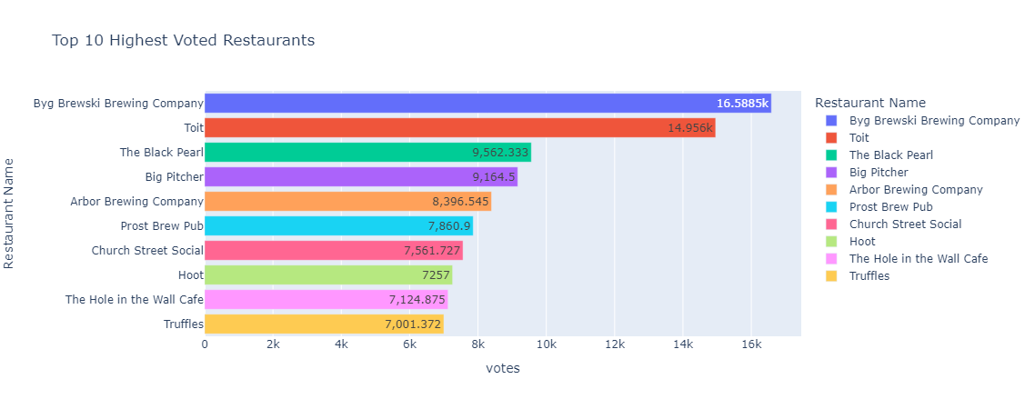
Top 10 highest voted restaurants
BYB is the most-rated restaurant by the users followed by Toit.

Slide 22
THANKYOU

